Slide 1
Module 7: Starting with connectors, screens, and controls

Slide 2
Module Overview
Screens
Navigation

Slide 3
Screens

Slide 4
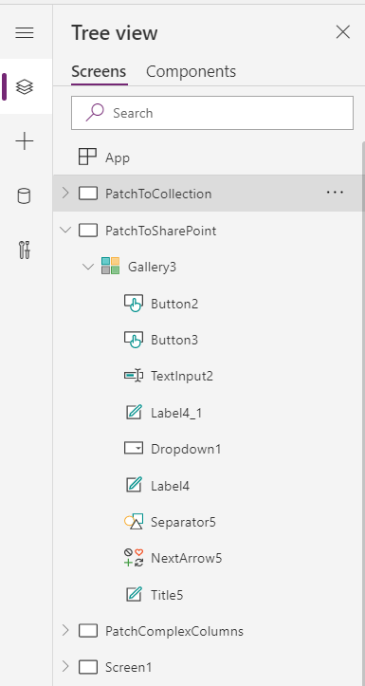
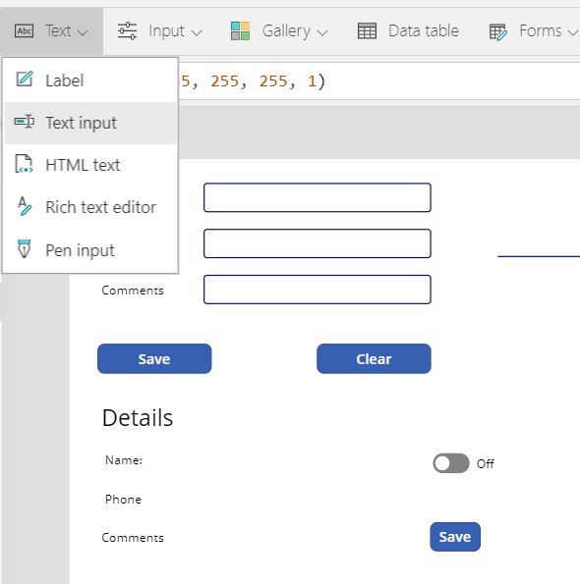
Screens and controls
Screens
Controls
Notes:
Mention:
On the left, we see how to create new screens, and how to access existing screens. Click on an existing screen to load it in the designer and edit it.
On the right, we see a list of controls that we can place on the currently active screen in the designer.
Discuss:
You build a PowerApps app by creating screens, and by navigating screens in response to user input. Users interact with screens via UI controls such as Radio Buttons, Text Boxes, Dropdowns, etc.
You control the look and behavior of these UI controls via Formulas in the Formula bar. Anyone familiar with Excel formula bar programming will be comfortable working with Power Apps controls and formulas.

Slide 5
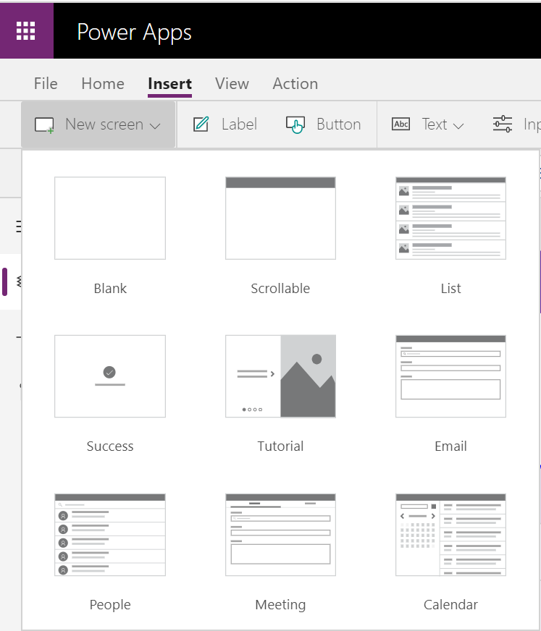
Screen Templates
Blank
Scrollable
List
Success
Tutorial
Email
People
Meeting
Calendar
Templates can be further customized
Designed to work together, using shared collection like MyPeople
Navigation is not by default
Limitations on searches:
People 15 results
Rooms 20 results
Notes:
Discuss:
Blank – Allows you to customize to look the way you want
Scrollable – Provides a scroll bar on the right side of the screen, so that you can move thru the controls in different sections
List – Behaves like a list view and allows for users to add some controls
Success - This simple screen can be used anywhere you want to add confirmation for a user action. For example after submitting a form or sending a meeting invite.
Tutorial - Use this as the first screen in your app to guide users on how to use your app.
Email - Add this screen anywhere in your app to send an email.
People - Search for users in your organization. We automatically add the Office 365 Users connection populate the MyPeople gallery with selected users.
Meeting - Quickly send a meeting invite via Outlook. Suggested meeting times are automatically populated streamlining the process.
Calendar - View your schedule for any given date. Use the components from this screen to add custom calendar functionality to your app.
https://powerapps.microsoft.com/en-us/blog/new-screen-templates/

Slide 6
Working with screens
Add multiple screens and name them. The name becomes a global variable.
Pass context between screens as a parameter to these formulas.
Notes:
When you add screens to your app, be sure to name them. Then you can access them as a global variable in the formula bar from any other screen.
To navigate from screen to screen, use a control event, such as a Button’s Click property, and leverage the Navigate() or Back() formulas. When you invoke these formulas, they can accept an input parameter that allows you pass objects, collections, data sets, or other contextual data to the next page. For example, when looking at a list of orders and an order is clicked, you can navigate to the Order Details screen and pass the ID of the order that was clicked.
When you use the Back() formula, it works similar to the Back button in Android (or Back in a web browser).

Slide 7
Navigation

Slide 8
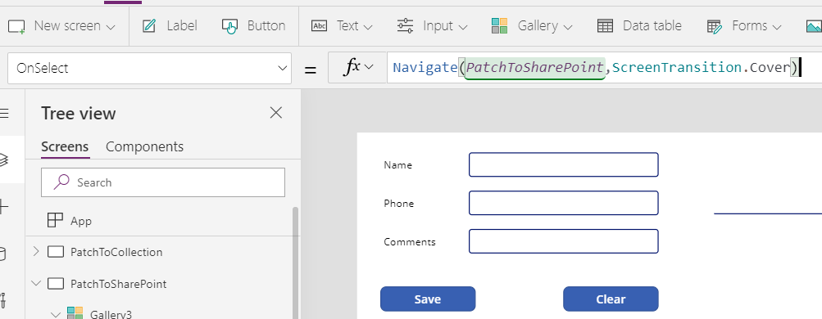
Navigate between screens
Navigate screens with Navigate() or Back() formulas from controls.
You can always get the current screen with App.ActiveScreen.
Back() works like the Back button in Android

Slide 9
Configuring screens and controls
Objectives
After completing this lab, you will be able to:
Rename screens in Power Apps Studio.
Add and manipulate the label control in Power Apps Studio.
Scenario
The organization wishes to build apps using the Power Apps platform to take advantage of No Code/Low Code application development in the cloud. As part of this effort, you are required to use PowerApps Studio and manipulate different screens and controls.
Notes:
See lab file M2_PowerApps_PowerUser_StartingwithConnectorsScreensandControls.docx and complete all tasks

Slide 10
Connector overview
Screens
Navigation

